Slide 1

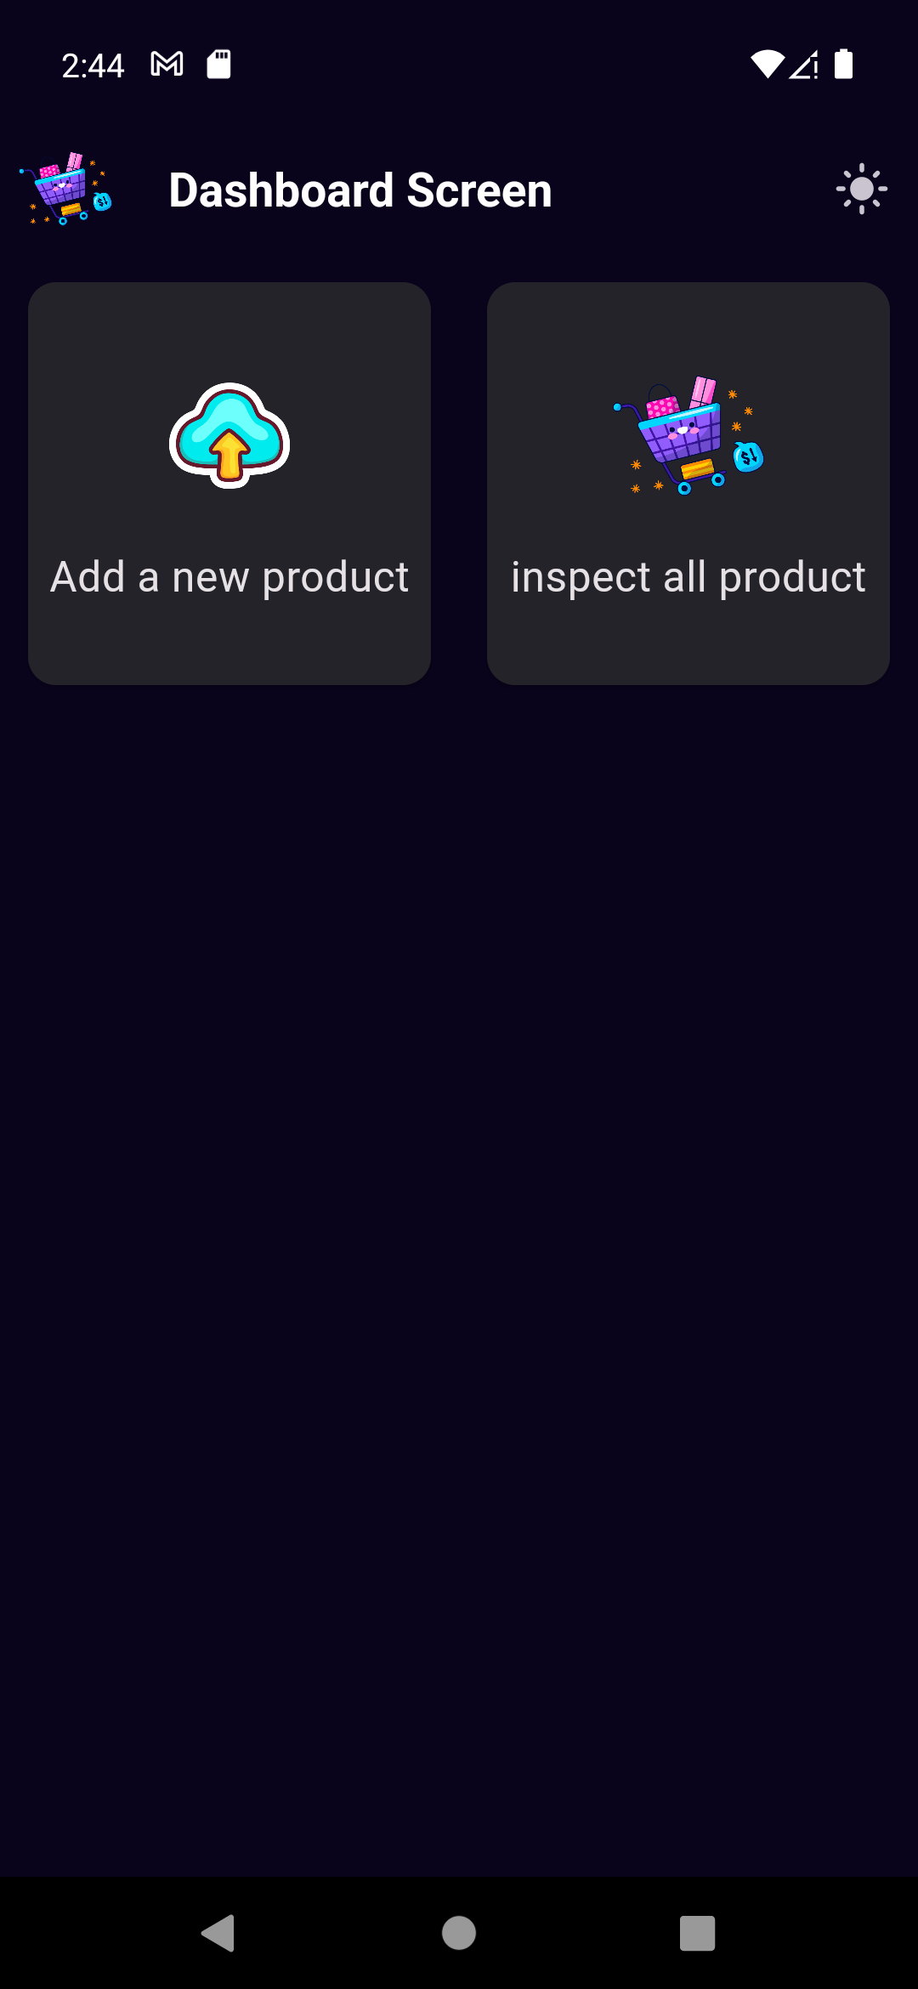
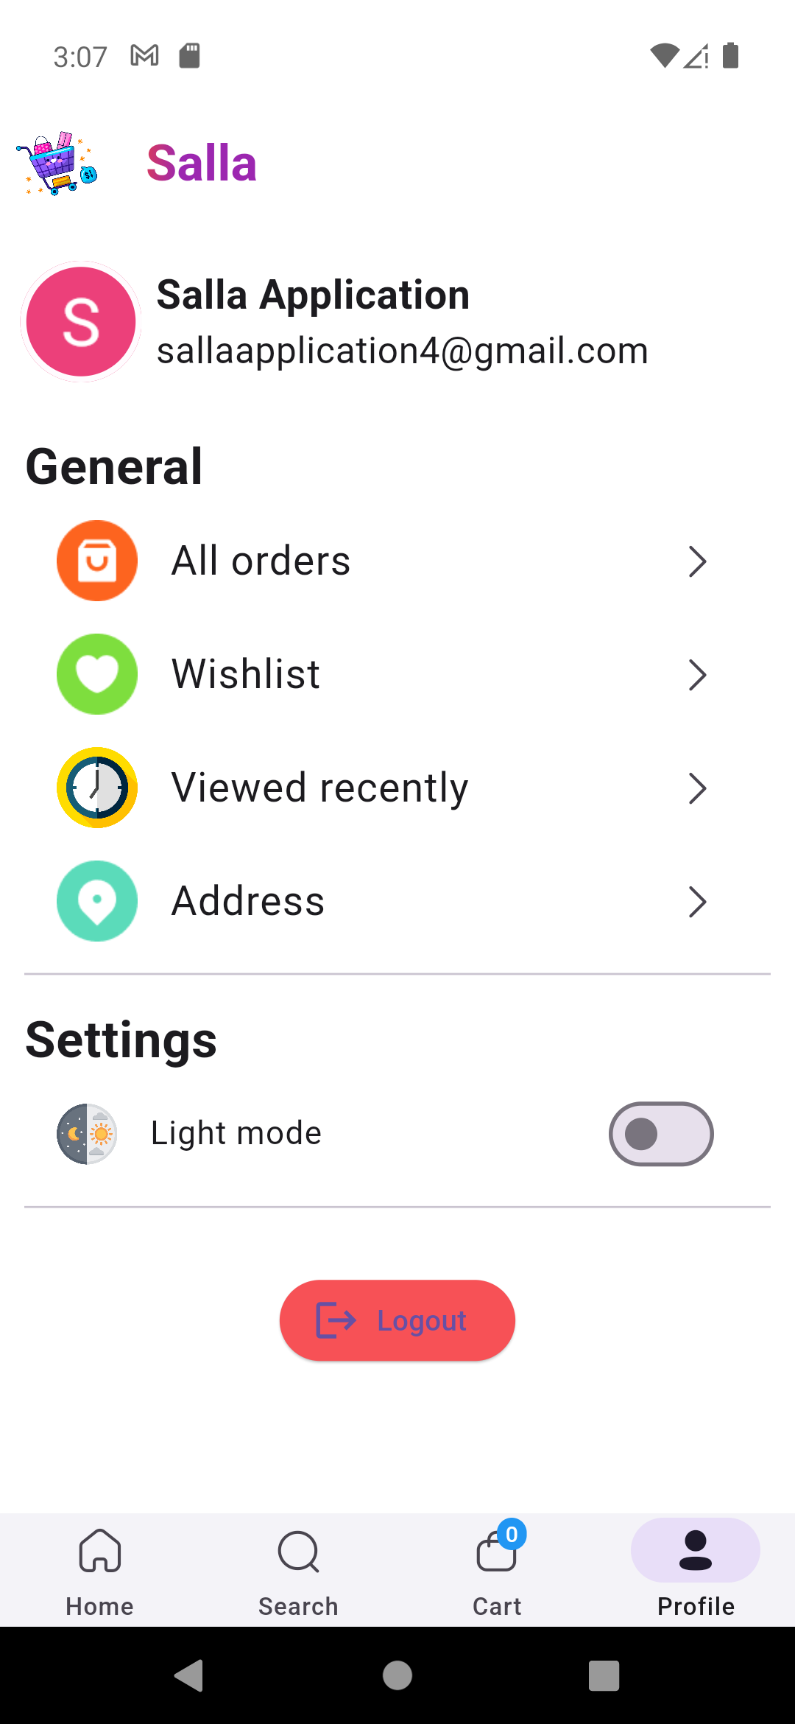
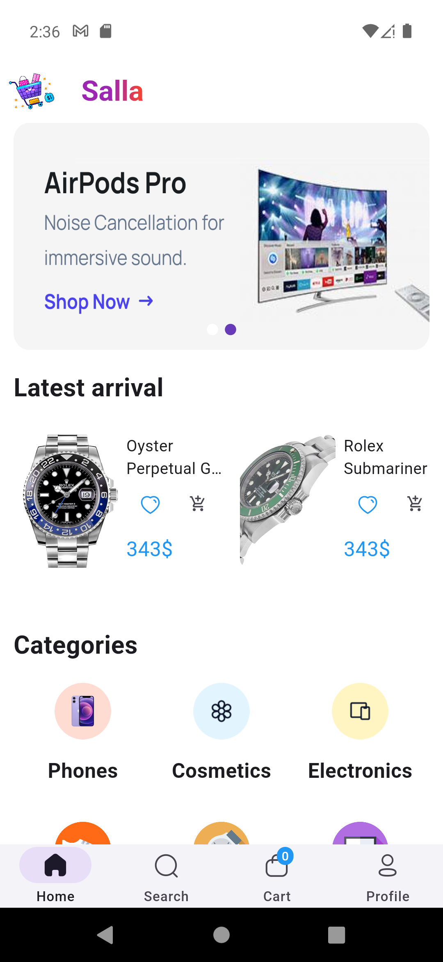
Salla Ecommerce Flutter App
Salla Ecommerce App – a user-friendly platform that allows seamless login, registration, and wish list features. Experience both dark and light themes for an enhanced shopping experience.

Slide 2
Introduction
1
User Features
2
Admin Features
Enjoy the convenience of user authentication, wishlist and cart functionality, ordering and payment process, and search and detailed product screens. Personalize your experience with profile and recently viewed screens, and easily recover your account with the Forgot Password feature.
Take control with the ability to add, delete, and edit products. Inspect all products effortlessly and make use of the intuitive dark theme. Drive your business forward seamlessly with Firebase integration.

Slide 3
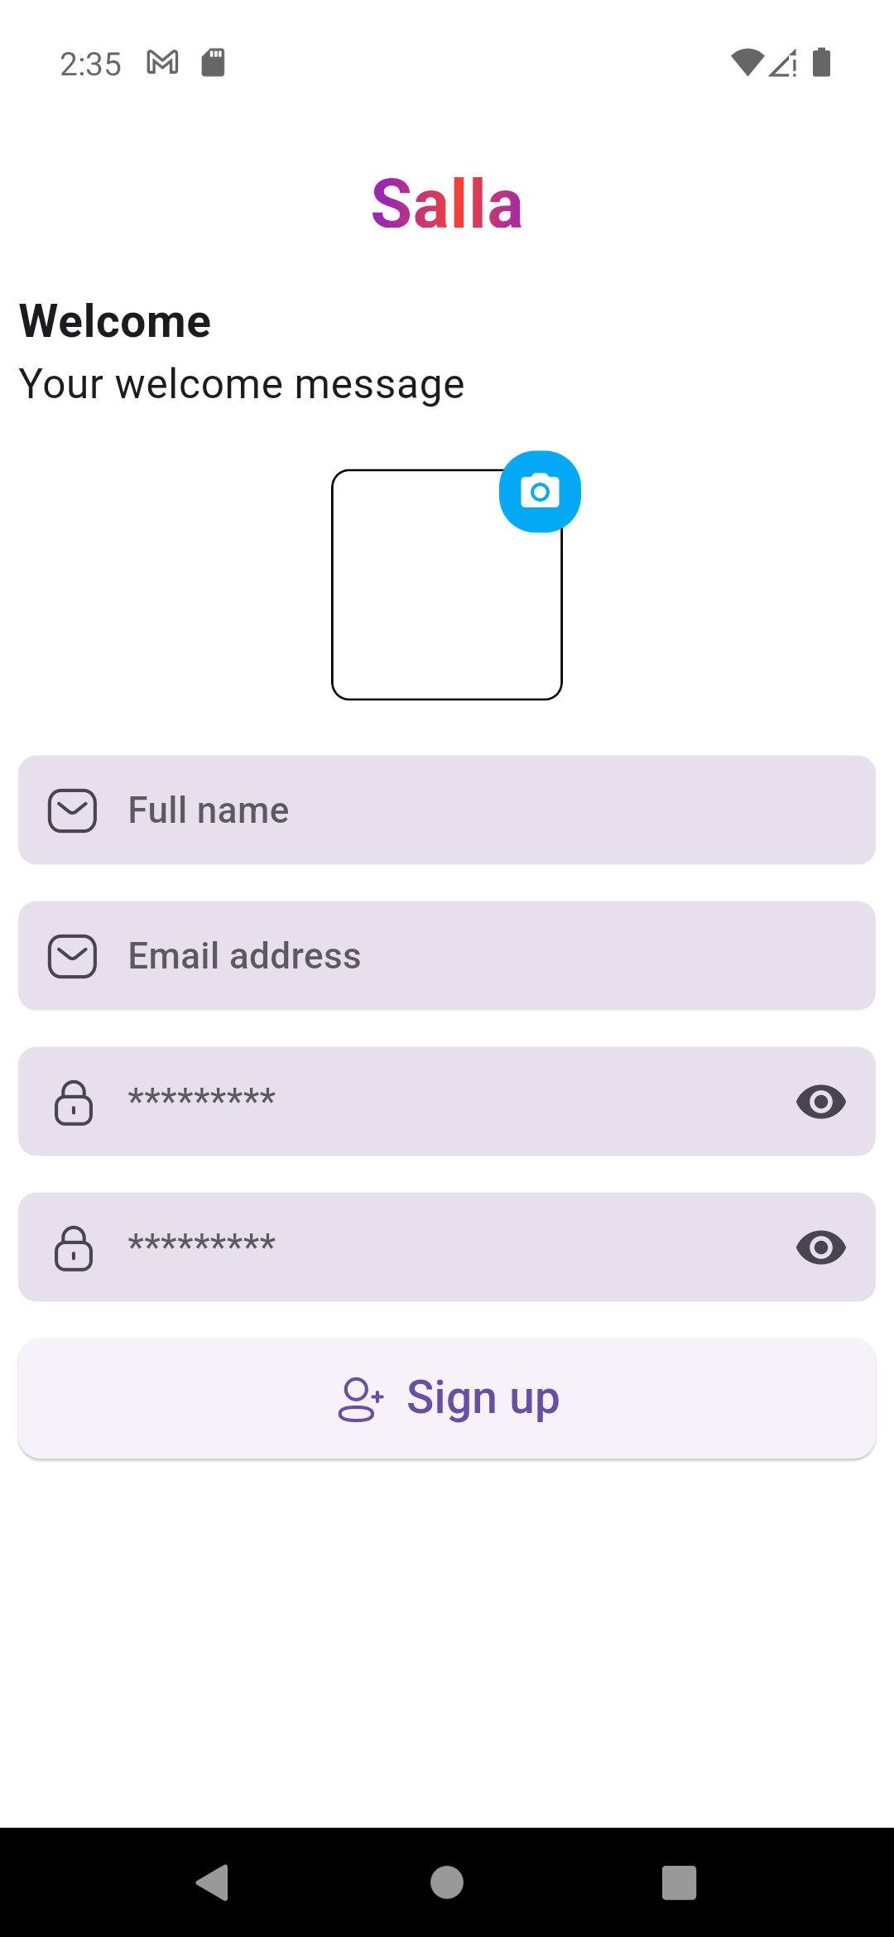
Register
The Register Screen is a critical interface enabling user account creation. It involves collecting essential information, ensuring password security, and providing a seamless, user-friendly experience.

Slide 4
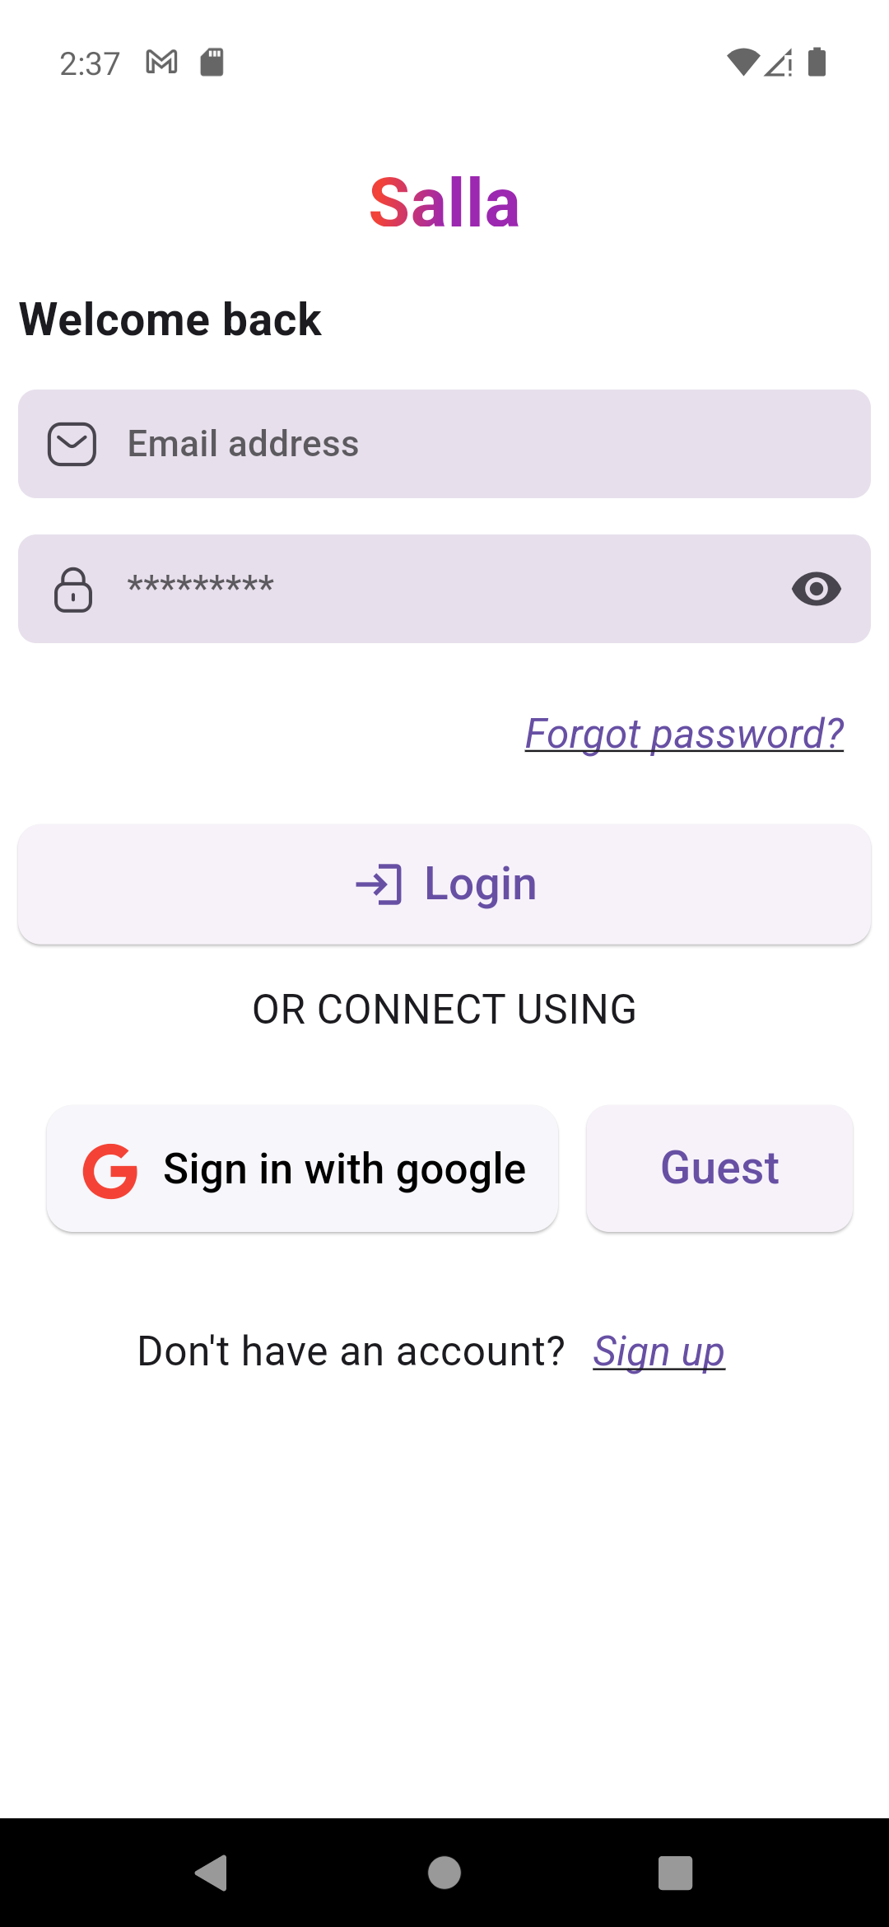
Login
The Login Screen serves as the entry point for users to access their accounts, typically requiring authentication through credentials like username and password. It focuses on user security, intuitive design, and efficient account access.

Slide 5
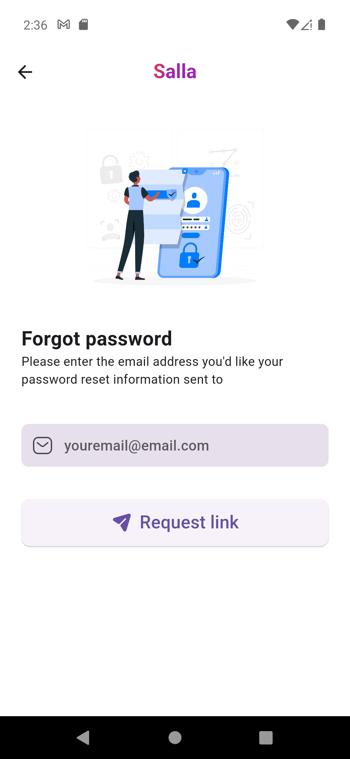
Forget Password
The "Forgot Password" feature provides a mechanism for users to reset their forgotten passwords. It often involves email verification or security questions to verify the user's identity before allowing them to set a new password.

Slide 6
Home Screen
The Home Screen is the central interface of an application, serving as the starting point for users. It provides an overview of essential features and content, facilitating easy navigation and access to key functionalities.

Slide 7
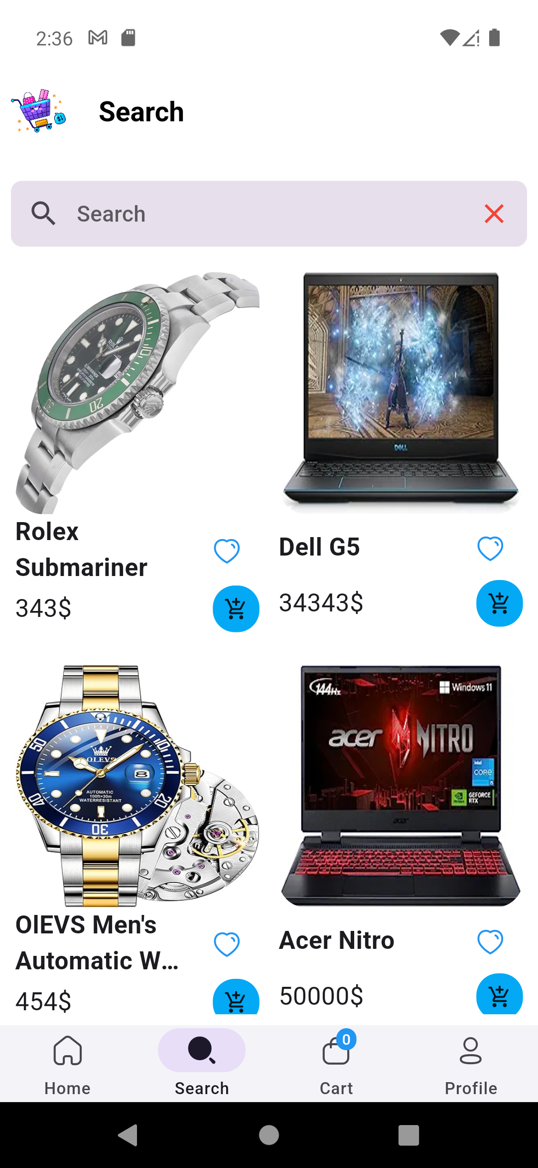
Search Screen
The Search Screen is a dedicated interface within an application that allows users to input queries and retrieve relevant content or information. It typically includes search bars, filters, and sorting options to enhance the user's ability to find specific items efficiently.

Slide 8
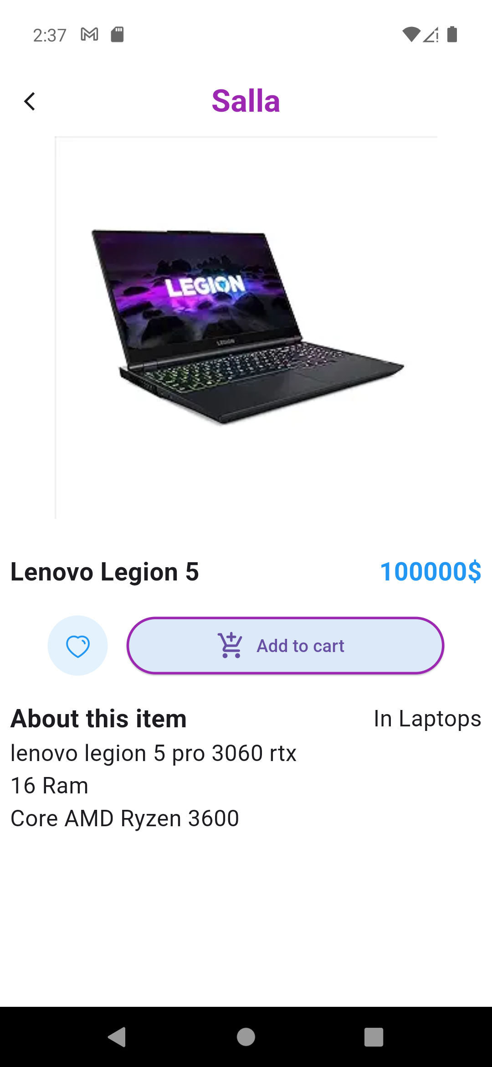
Product details
user interface that displays comprehensive information about a specific product. It typically includes details such as product images, descriptions, prices, and any other relevant information. Flutter, as a UI toolkit, enables developers to design visually appealing and responsive product detail screens for mobile applications.

Slide 9
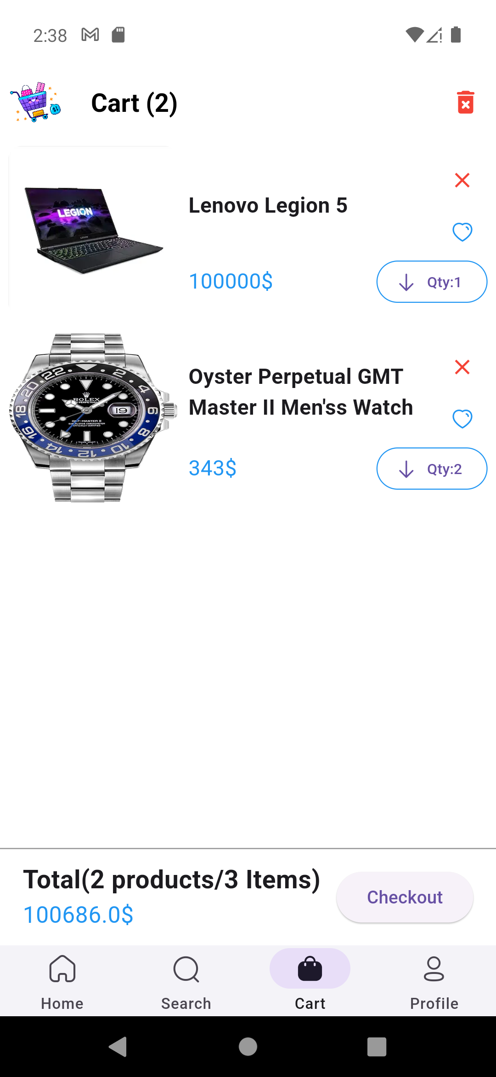
Cart Screen
virtual shopping cart where users can review and manage the items they have added for purchase. It typically displays product names, quantities, prices, and provides options for users to modify their cart contents, such as adding or removing items before proceeding to checkout.

Slide 10
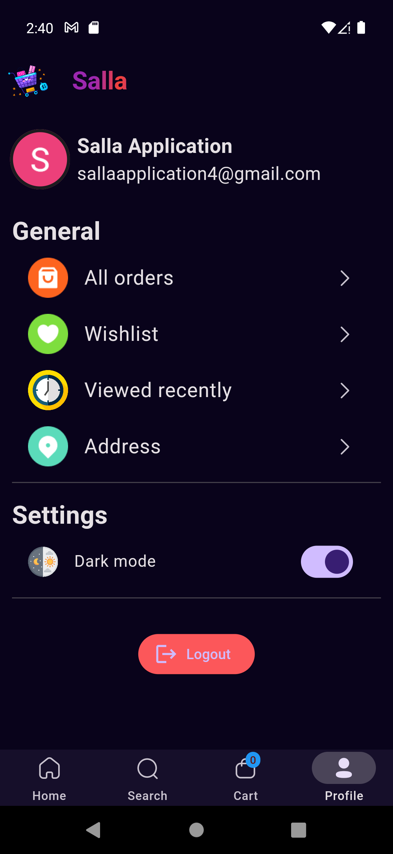
Profile Screen
presents personalized information about a user. It often includes details such as the user's name, profile picture, contact information, and account settings

Slide 11
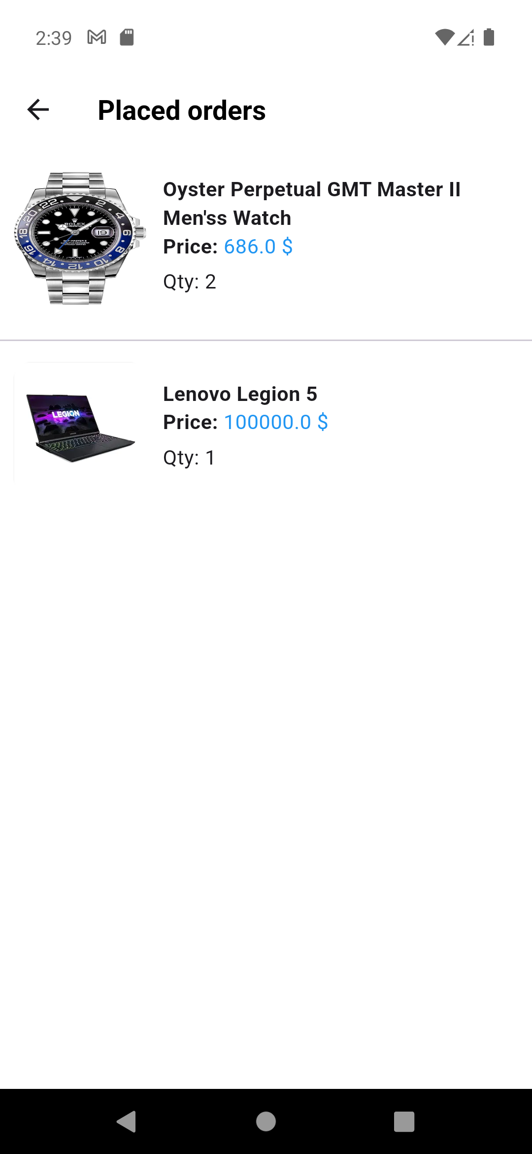
Order History
provides a chronological record of a user's past transactions and purchases. It typically includes details such as order dates, itemized lists of purchased products, order statuses, and links to view specific order details.

Slide 12
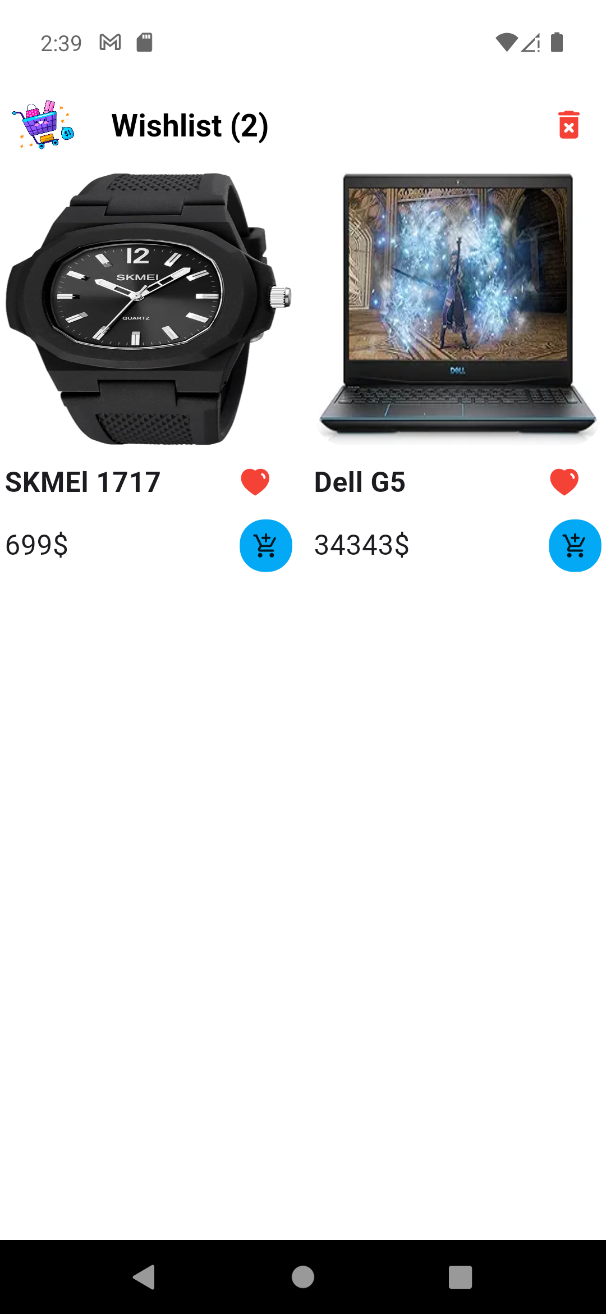
Wishlist Screen
collection of products or items that a user has marked as favorites or desires to purchase in the future. Users can typically add or remove items from the wish list, and the screen often includes product names, images, and links for easy navigation to product details.

Slide 13
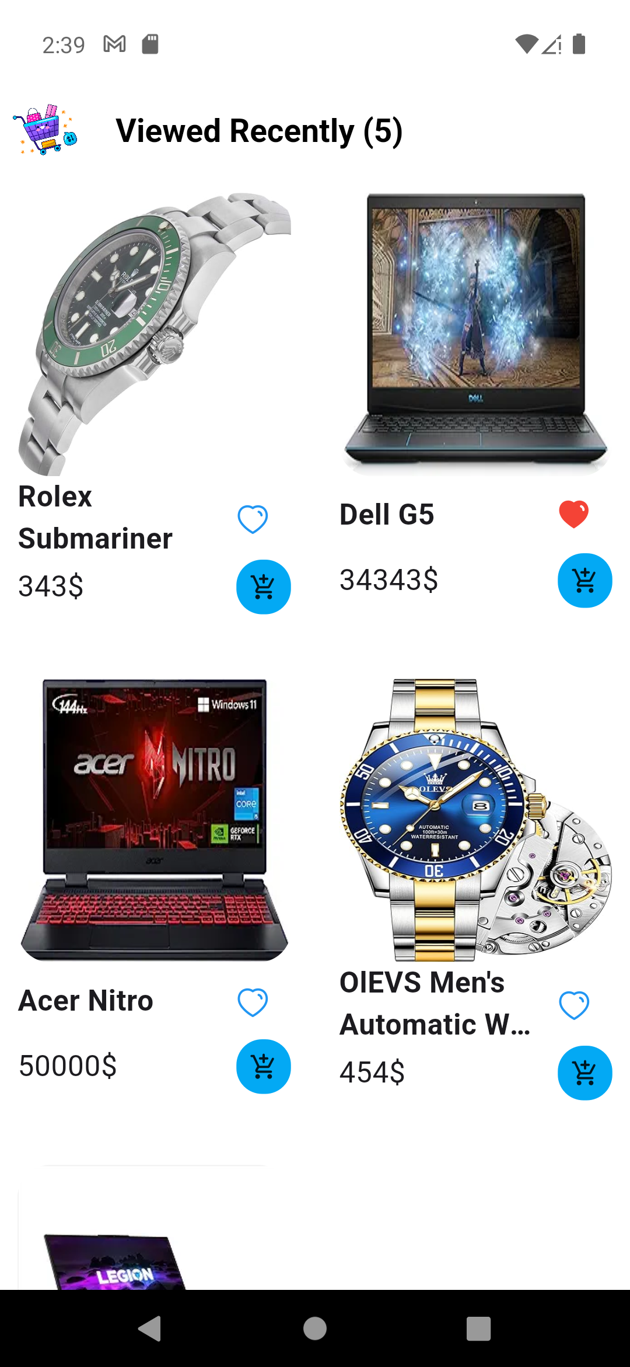
Recenlty Viewed
a history of products or content that a user has recently interacted with or viewed. It enables users to quickly revisit items they have recently explored, promoting easy navigation and facilitating a seamless user experience

Slide 14
Dashboard
functionalities for adding, deleting, and updating products. It provides administrators with a streamlined interface to efficiently manage the product catalog of an application or e-commerce platform

Slide 15
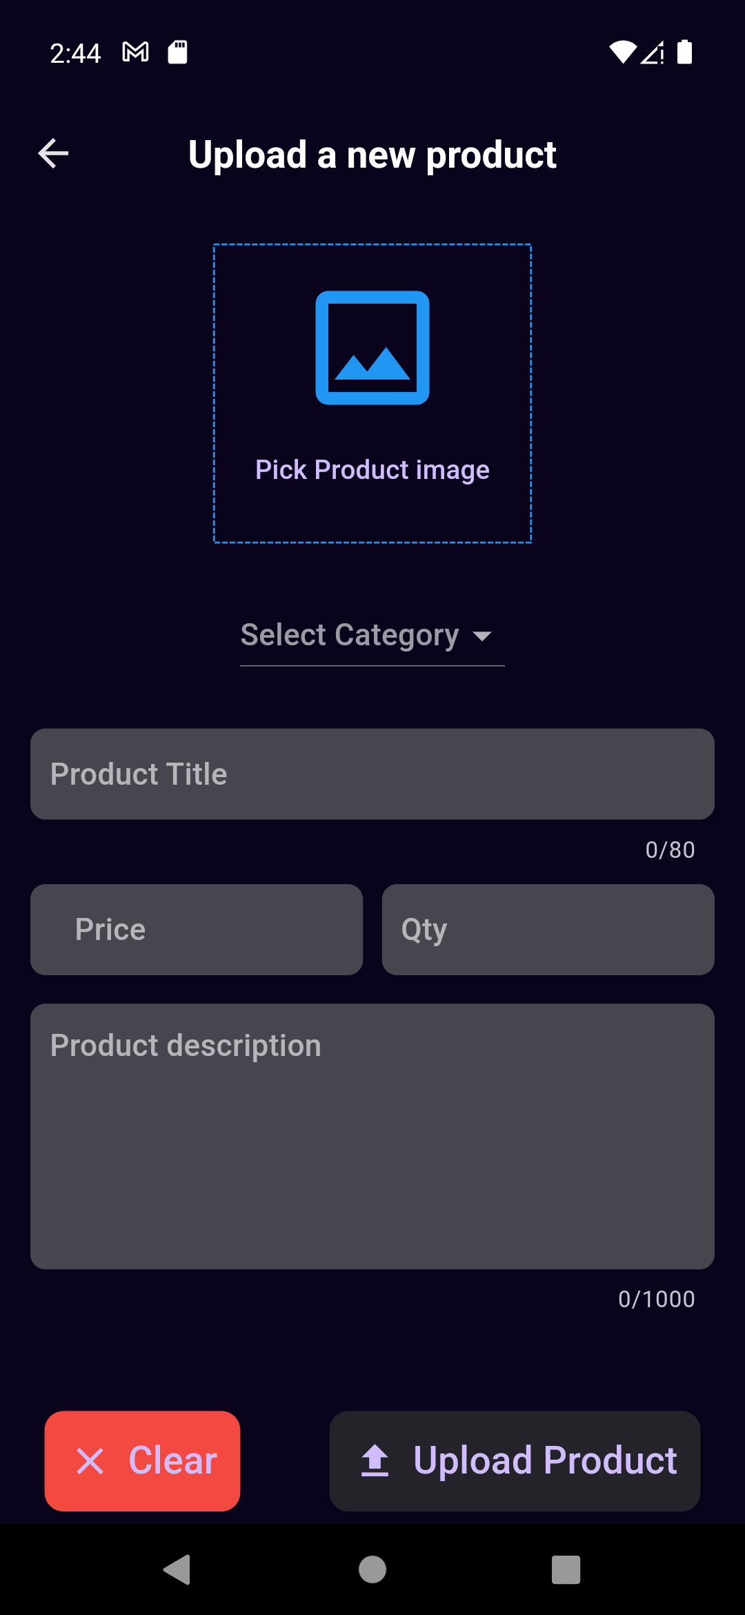
Upload Product
y allows administrators or sellers to add new products to an application or e-commerce platform. It typically involves providing details such as product name, description, images, price, and other relevant information.

Slide 16
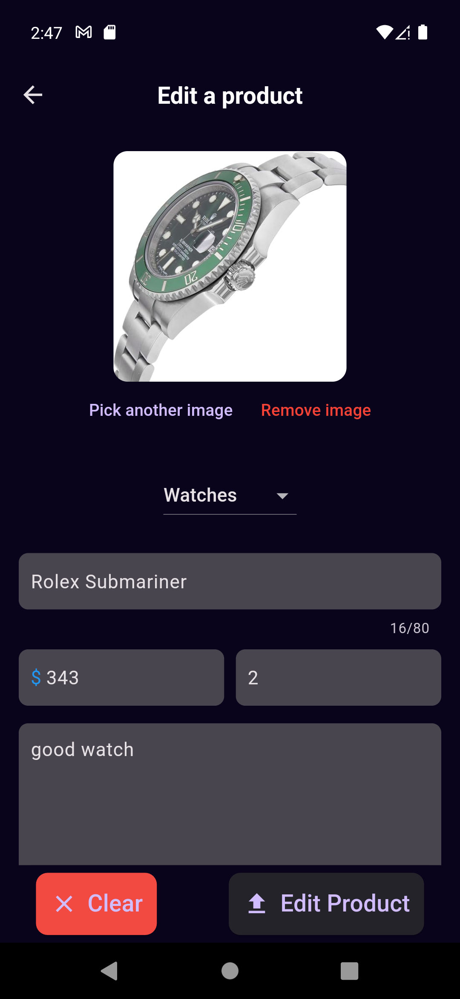
Edit Product
allows administrators or sellers to modify existing product information. It provides a user-friendly interface for updating details such as product name, description, images, price, or any other relevant attributes

Slide 17

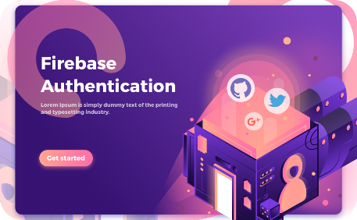
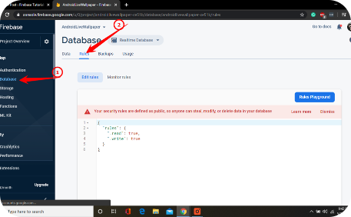
Firebase Integration
Scaled for Success
Secure Authentication
Effortless Data Management
Integrate seamlessly with Firebase to enhance your app's performance and scalability. Trust a robust and reliable backend infrastructure.
Protect user data and ensure secure login and registration processes with Firebase authentication. Give your users peace of mind.
Enjoy simplified data management with Firebase. Store and retrieve information effortlessly, making your app highly efficient.

Slide 18

Thank You
Thank you for exploring the incredible features of the Salla Ecommerce Flutter app. Elevate your online shopping experience with us today!

